Slide 1
Alzheimer’s Disease Detection using Deep Learning

Slide 2
ABSTRACT
In the proposed methodology, the MRI data is used to identify the AD and Deep Learning technique is used to classify the present disease. The classification of Alzheimer’s disease using deep learning methods has shown promising results, and successful application in clinical settings requires a combination of high accuracy, short processing time, and generalizability to various populations.

Slide 3
EXISTING SYSTEM
The study by Veeramuthu et al. (2014) developed a CAD tool for decision making about the presences of abnormalities in human brain. The author suggested preprocessing of PET dataset for instance, spatial normalization and intensity normalization. Fisher Discriminants ratio (FDR) was used for feature extraction to get ROIs. The instances were classified to normal if the extracted number of verified rules were above the final threshold otherwise image was classified as AD

Slide 4
The authors claimed 91.33% accuracy with 82.67% sensitivity & 100% specificity in comparison with other methods as VAF, PCA+SVM, and NFM+ SVM. It is observed that the authors did not mention the number of instances used in dataset. The methods adopted for dealing the missing data and class imbalance are also ignored. The dataset taken for the proposed study is not pathologically proven. Support and confidence, effective parameters of AR mining, are not discussed as well as no method for validation has been mentioned by the authors.

Slide 5
R. Chaves et al. (2012), impressed from the findings of PET data, tried to improve the prediction accuracy of the AD especially in early stage which has been of most concern to the researchers. The aim was the improvement in diagnosis of AD using Apriori AR progression and to develop new treatments and monitor their effectiveness while reducing the computational time and cost of clinical trials.

Slide 6
The authors have introduced a method for analyzing of Alzheimer’s disease by incorporating more detailed PET for instance, FDG-PET and PiB-PET. The data set comprised of 103 participants where 19 were control (CTRL), 19 were AD patients and 65 were with Mild cognitive impairment (MCI). The authors came with good results for PiB PET having classification accuracy of 97.37% and in combination with FDG it achieved the classification accuracy of 94.74% while FDG PET alone received 92.11% accuracy. The proposed method worked with a very small sized pathologically unproven data set with a class imbalance problem which produces uncertainty in the acquired accuracies.

Slide 7
DISADVANTAGES OF EXISTING SYSTEM
The existing system revealed noise.
The existing system has small sample size which is very challenging to achieve good classification accuracy.
Pathologically unproven data with no justification about missing values.
The data may contain Missing values which will cause uncertainty.
The most common problems among them were the input size, attributes and validation

Slide 8
PROPOSED SYSTEM
The aim of this proposed system is to identify the stage of Alzheimer’s Disease (AD) patients through the deep learning models. This process facilitates the monitoring of the disease and allows actions to be taken in order to provide the optimal treatment and the prevention of complications.

Slide 9
Alzheimer’s disease (AD) is a progressive mental deterioration and incurable neurodegenerative disease that can occur in middle or old age, due to generalized degeneration of the brain. Because of the irreversible nature of the progression of Alzheimer’s disease, the early diagnosis of AD has an immense clinical, social, and economic need. This research output proposing a state-of-the-art, easy, and early automated deep learning-based system to predict AD from a large MRI dataset of normal and diseased subjects.

Slide 10
In the proposed system, it is classified into Mild Demented, Moderate Demented, Non-Demented, Very Mild Demented. Using Convolutional Neural Network architecture, the classification is done and results are predicted. The proposed system achieved training accuracy of 86.34% and validation accuracy of 86.45%.

Slide 11
ADVANTAGES OF PROPOSED SYSTEM
For the prediction of diseases such as Alzheimer, applying highly accurate computational - automated machine learning – tools will help to diagnose the disease in the early stage itself and provide a better clinical, social and economic outcome.

Slide 12
In the proposed system, based on the classification accuracy and prediction responses, Convolutional Neural Network architecture is coming as the most convenient system for pattern recognition and prediction problems like Alzheimer’s Disease detection system.
This model is can help to improve the prediction performance by physicians and cover the limitations pointed out in the previous research.

Slide 13
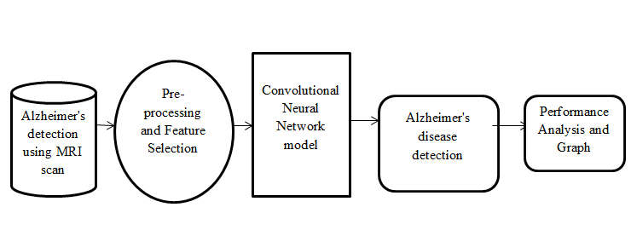
SYSTEM ARCHITECTURE

Slide 14
HARDWARE REQUIREMENTS
System : Pentium i3 Processor.
Hard Disk : 500 GB.
Monitor : 15’’ LED
Input Devices : Keyboard, Mouse
Ram : 4 GB

Slide 15
SOFTWARE REQUIREMENTS
Operating system : Windows 10.
Coding Language : Python
Web Framework : Flask

